Slide 1
I/O
Basics of I/O
Byte streams vs Char streams
Files
Buffering
Serialization

Slide 2


I/O in java
In java, stream based input/output is supported(most real applications of java use AWT(text box etc) for inputs).
A stream is an abstraction for flow of data(either produces or consumes information).
An input stream can abstract many different kinds of I/P: from a disk file, a keyboard or a N/W socket.

Slide 3
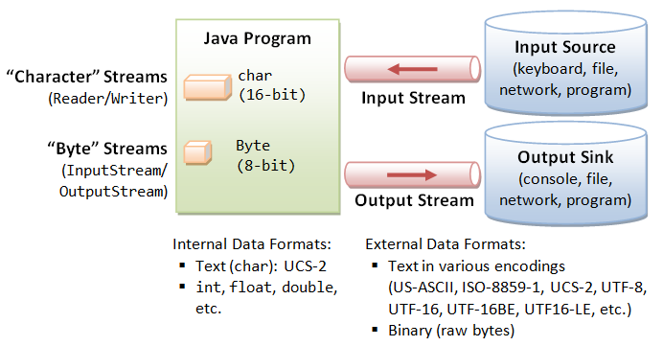
Contd…
This is either a source or a destination for the data.
Java defines 2 types of streams: Byte Streams(old) and char streams.
Byte streams provide a convenient means for handling input and output of bytes( reading or writing binary data).
Char streams handles input and output of characters(Unicode).
Different streams have different characteristics:
  A file has a definite length, and therefore an end
  Keyboard input has no specific end

Slide 4
How to do I/O
import java.io.*;
Open the stream
Use the stream (read, write, or both)
Close the stream

Slide 5
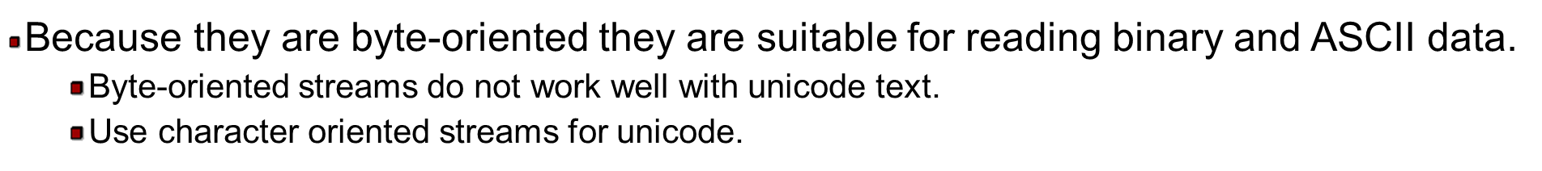
Byte stream
InputStream(abstract class)
OutputStream(abstract class)
BufferedInputStream
DataInputStream
FileInputStream
BufferedOutputStream
DataIOutputStream
FileOutputStream
PrintStream

Slide 6
character stream
character stream
Reader(abstract class)
Writer(abstract class)
BufferedReader
FileReader
BufferedWriter
FileWriter
PrintWriter
InputStreamReader
OutputStreamReader

Slide 7
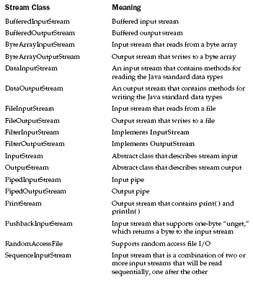

Slide 8
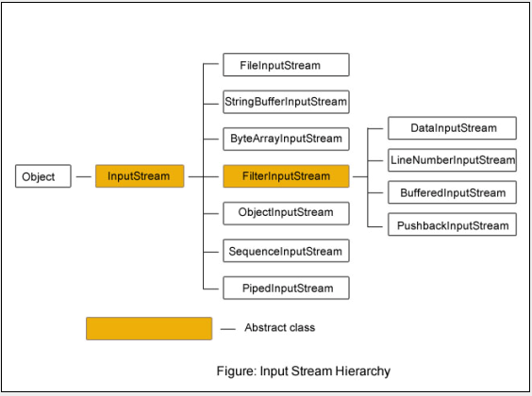
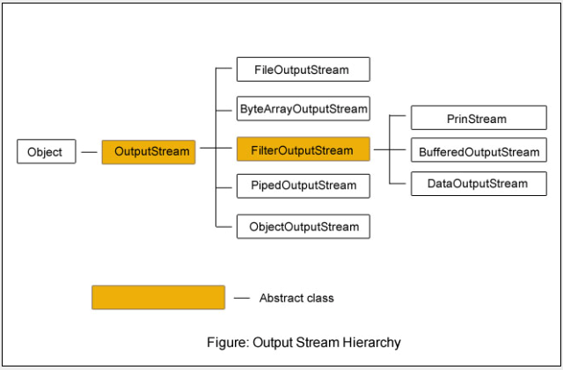
Anumita Jha

Slide 9
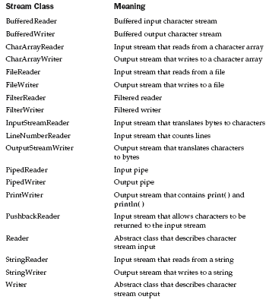


Slide 10
Contd……..
Streams that input and output bytes to files are known as byte-based streams, storing data in its binary format.
Streams that input and output characters to files are known as character-based streams, storing data as a sequence of characters.
For instance, if the value 5 were being stored using a byte-based stream, it would be stored in the binary format of the numeric value 5, or 101. If the value 5 were being stored using a character-based stream, it would be stored in the binary format of the character 5, or 00000000 00110101 (this is the binary for the numeric value 53, which indicates the character 5 in the Unicode character sets).

Slide 11
Standard(predefined)Streams
Lang package defines a class called System, which encapsulates several aspects of the run-time environment.
System.in,System.out,System.err
In,out,err are public, static object members of system class.
System.out refers to standard output stream( console by default)
System.in refers to keyboard.
System.err refers to console( used to differentiate between normal output and error output in the code to make the code more readable)

Slide 12
File object
A File object is used to obtain or manipulate the information associated with a disk file, such as the permissions, time, date and directory path.
It deals with File system directly
It defines many methods that obtain standard properties of files.
constructors for creating File objects:
File(String directorypath)
File(String directorypath, String filename)
File(File dirobj, String filename)
  Ex:
  File f1 = new File("/test/");
  File f2 = new File("/test/","autoexec.bat");
  File f3 = new File(f1,"autoexec.bat");

Slide 13
File example
listing 1
// Demonstrate File.
import java.io.File;
class FileDemo {
public static void main(String args[]) {
File f1 = new File(“c:/java/COPYRIGHT");
S.O.P("File Name: " + f1.getName());
S.O.P("Path: " + f1.getPath());
S.O.P("Parent: " + f1.getParent());
S.O.P(f1.exists() ? "exists" : "does not exist");
S.O.P("is " + (f1.isDirectory() ? "" : "not" + " a directory"));
S.O.P(f1.isFile() ? "is normal file" : "might be a named pipe");
S.O.P("File last modified: " + f1.lastModified());
S.O.P("File size: " + f1.length() + " Bytes");
}
}
Refer e-books or sun tutorial for some other methods.

Slide 14
Directory
// Using directories.
import java.io.File;
class DirList {
public static void main(String args[]) {
File f1 = new File(“c:/java“);
if (f1.isDirectory()) {
System.out.println("Directory of " + dirname);
String s[] = f1.list(); //returns list of files and directoriesinside
for (int i=0; i < s.length; i++) {
File f = new File(“c:/java” + "/" + s[i]);

Slide 15
Contd
if (f.isDirectory()) {
System.out.println(s[i] + " is a directory");
} else {
System.out.println(s[i] + " is a file");
}
}
} else {
System.out.println(dirname + " is not a directory");
}
}
}

Slide 16
Byte stream
Byte stream
InputStream(abstract class)
OutputStream(abstract class)
BufferedInputStream
DataInputStream
FileInputStream
BufferedOutputStream
DataIOutputStream
FileOutputStream
PrintStream

Slide 17
Byte streams
Provides rich environment for handling byte-oriented I/O.
2 abstract classes: InputStream and OutputStream.
InputStream:
Some of the methods of InputStream abstract class
Int available(): returns no of bytes currently available for reading.
Void close(): close the I/P source.
Int read(): returns integer representation of next available input.
Void mark(int no of bytes): places a mark at current point in the input stream that will remain valid until no of bytes are read.
Int read(byte buffer[]): attempts to read upto buffer.length bytes into buffer and returns actual num of bytes actually read.
int read(byte buffer[ ], int offset,int numBytes)--Attempts to read up to numBytes bytes into buffer starting at buffer[offset], returning the number of bytes successfully read.
NOTE:
1.These methods are overridden by the subclasses of InputStream class
2. Refer textbook for more methods….

Slide 18
Contd…
Outputstream:
Is an abstract class that defines streaming byte output.
All the methods in this class return a void value and throw an IOException in case of errors.
Some of the methods:
Void close(): closes outputstream
Void write(int b):writes a single byte to an O/P stream.
Void write(byte buffer[]): writes complete array of bytes to an o/p stream.
Note:refer textbook for more methods

Slide 19
File streams
FileInputstream
FileOutputStream
Anumita Jha

Slide 20
FileInputStream
Creates an inputstream that can be used to read bytes from a file.
Constructors:
FileInputStream(String filepath)
FileInputStream(File fileobj)
Ex:
1.FileInputStream f0 = new FileInputStream("/autoexec.bat")
2. File f = new File("/autoexec.bat");
FileInputStream f1 = new FileInputStream(f);
Either can throw FileNotFoundException.
FileInputStream overrides all the methods of InputStream except mark() and reset().

Slide 21
Reading char by char using FIS
import java.io.*;
class ShowFile {
public static void main(String args[])
throws IOException
{
int i;
FileInputStream fin;
try {
fin = new FileInputStream(args[0]);
} catch(FileNotFoundException e) {
System.out.println("File Not Found");
return;
Anumita Jha

Slide 22
Contd….
} catch(ArrayIndexOutOfBoundsException e) {
System.out.println("Usage: ShowFile File");
return;
}
// read characters until EOF is encountered
do {
i = fin.read();
if(i != -1) System.out.print((char) i);
} while(i != -1);
fin.close();
}
}
Anumita Jha

Slide 23
Copy File to another
import java.io.*;
class CopyFile {
public static void main(String args[])
throws IOException
{
int i;
FileInputStream fin;
FileOutputStream fout;
try {
// open input file
try {
fin = new FileInputStream(args[0]);
} catch(FileNotFoundException e) {
System.out.println("Input File Not Found");
return;
}

Slide 24
// open output file
try {
fout = new FileOutputStream(args[1]);
} catch(FileNotFoundException e) {
System.out.println("Error Opening Output File");
return;
} } catch(ArrayIndexOutOfBoundsException e) {
System.out.println("Usage: CopyFile From To");
return;
}
// Copy File
try {
do {
i = fin.read();
if(i != -1) fout.write(i);
} while(i != -1);
} catch(IOException e) {
System.out.println("File Error");
}
fin.close();
fout.close();
}}
Anumita Jha

Slide 25
FileInputStream example( reading into buffer)
// Demonstrate FileInputStream.
import java.io.*;
class FileInputStreamDemo {
public static void main(String args[]) throws Exception {
int size;
FileInputStream f =
new FileInputStream("FileInputStreamDemo.java");
System.out.println("Reading the next " + n + " with one read(b[])");
byte b[] = new byte[10];
int k=f.read(b)
f.close();
}
}

Slide 26
FileoutputStream
Creates an outputstream that can be used to write bytes to a file.
Constructors:
FileOutputStream(String filepath)
FileOutputStream(File fileobj)
FileOutputStream(String filepath, boolean append)
FileOutputStream(File fileObj, boolean append)
All 3 can throw FileNotFoundException.
Here,
filepath is the full path name of the file.
fileobj is a File object that describes the file.
If append is true, file is opened in append mode.

Slide 27
Writing char,buffer, byte into file using FOS
import java.io.*;
class FileOutputStreamDemo {
public static void main(String args[]) throws Exception {
String source = "welcome to java";
byte buf[ ] = source.getBytes(); //gets byte equivalent
FileOutputStream f0 = new FileOutputStream("c:\\text\\abc.txt");
f0.write(buf); //write entire buffer into file
f0.close();
FileOutputStream f1 = new FileOutputStream("c:\\text\\def.txt");
f1.write('a'); //write a single char
f1.close();
FileOutputStream f2 = new FileOutputStream("c:\\text\\ghi.txt");
f2.write(65);
f2.close();
FileOutputStream f3 = new FileOutputStream("c:\\text\\klm.txt");
//f3.write("hai"); //error
f3.close();
}
}

Slide 28
Buffered byte streams
A buffered stream extends a filtered stream class by extending a memory buffer to I/O streams.
This buffer allows java to do java I/O operations on more than a byte at a time, hence increasing performance.
Since the buffer is available, skipping, marking and resetting of the stream is possible.

Slide 29
BufferedInputStream
Allows you to “wrap” any InputStream into a buffered stream and achieve performance improvement.
Constructors:
BufferedInputStream(InputStream inputstream)
BufferedInputStream(InputStream inputstream, int bufsize)
here,
First form creates a buffered stream with a default buffer size(dependent on host OS, amount of memory available).
In Second, size is passed as argument.
buffering also supports moving backward in the stream of available buffer( i.e apart from read() and skip() methods, it also supports mark() and reset() methods)
There are 2 buffered byte stream classes:
1.BufferedInputStream
2.BufferedOutputStream

Slide 30
Reading char by char using BIS
import java.io.*;
class ShowFile {
public static void main(String args[]) throws IOException
{
int i;
FileInputStream fin;
BufferedInputStream bin;
fin = new FileInputStream("c:\\text\\abc.txt");
bin= new BufferedInputStream(fin);
// read characters until EOF is encountered
do {
i = bin.read();
if(i !=-1) System.out.print( (char)i);
} while(i != -1);
fin.close();
}
}

Slide 31
Reading data into buffer using BIS
import java.io.*;
class ShowFile {
public static void main(String args[]) throws IOException
{
int i;
byte buf[]=new byte[15];
FileInputStream fin = new FileInputStream("c:\\text\\abc.txt");
BufferedInputStream bin=new BufferedInputStream(fin);
int k=bin.read(buf);
System.out.println(new String(buf, 0, buf.length));
bin.close();
}
}

Slide 32
BufferedOutputStream
Allows you to “wrap” any OutputStream into a buffered stream and achieve performance improvement.
Reduces the number of times the system actually writes the data.
Constructors:
BufferedOutputStream(OutputStream outputstream)
BufferedOutputStream(OutputStream outputstream, int bufsize)
here,
First form creates a buffered stream with a default buffer size(512 bytes).
In Second, size is passed as argument.

Slide 33
Writing buffer using BOS
import java.io.*;
class ShowFile {
public static void main(String args[]) throws IOException
{
int i;
String str="hai hello";
byte buf[]=str.getBytes();
FileOutputStream fin = new FileOutputStream("c:\\text\\abc.txt“);
BufferedOutputStream bin= new BufferedOutputStream(fin);
bin.write(buf);
bin.write('a');
//bin.write("world"); //error
bin.write(65);
bin.close();
}
}

Slide 34
Example: mark,reset
import java.io.*;
class ShowFile {
public static void main(String args[]) throws IOException {
int i;
byte buf[]=new byte[15];
FileInputStream fin = new FileInputStream("c:\\text\\abc.txt");
FileOutputStream fout= new FileOutputStream("c:\\text\\def.txt");;
BufferedInputStream bin=new BufferedInputStream(fin);;
BufferedOutputStream bout=new BufferedOutputStream(fout);;
bin.mark(buf.length); //mark beginning of file until entire data is read
int k=bin.read(buf);
bout.write(buf);
bin.reset(); //reset the pointer to the previously set mark
do {
i = bin.read();
if(i !=-1) System.out.print( (char)i);
} while(i != -1);
bin.close();
bout.close();
}
}

Slide 35
Byte stream
Byte stream
InputStream(abstract class)
OutputStream(abstract class)
BufferedInputStream
DataInputStream
FileInputStream
BufferedOutputStream
DataIOutputStream
FileOutputStream
PrintStream

Slide 36
PrintStream
Used for ASCII output.
System.out is a PrintStream.
Constructors:
PrintStream(Outputstream os)
Supports print() and println() methods for all types.

Slide 37
Contd…
import java.io.*;
class ShowFile {
public static void main(String args[]) throws IOException
{
int i;
String str="hai";
FileOutputStream fin;
PrintStream pin;
fin = new FileOutputStream("c:\\text\\abc.txt");
pin= new PrintStream(fin,true);
pin.println("helloworld");
pin.println(str);
pin.println(123);
pin.println(55.5);
pin.print('a');
pin.close();
}
}

Slide 38
RandomAccessFile
It encapsulates a random access file.
It implements interfaces DataInput and DataOutput, which define basic I/O methods.
Also supports postioning the file pointer within the file.
Constructors:
RandomAccessFile(File fileobj,String access) throws IOException
RandomAccessFile(String filname,String access) throws IOException
access determines the type of file access(“r”, “rw”)
Ex:RandomAccessFile rf=new RandomAccessFile(“x.txt”,”r”);

Slide 39
RandomAccessFile Methods
void seek(long newpos) — Positions the file pointer just before the specified byte
long getFilePointer() — Returns the current byte location of the file pointer
Anumita Jha

Slide 40
Random access example 1
import java.io.*;
class RandAccessFile{
public static void main(String[] args) throws IOException{
File file = new File("c:\\text\\abc.txt");
try{
RandomAccessFile rand = new RandomAccessFile(file,"rw");
rand.seek(file.length()); //Seek to end of file
rand.writeChars("Roseindia.net");
rand.writeChars("450.5");
rand.close();
System.out.println("Write Successful");
}
catch(IOException e)
{
System.out.println(e.getMessage());
}
}}

Slide 41


Limitations of Byte Oriented Streams
Byte oriented streams are attractive to programmers familiar with C, C++ or who have UNIX experience
  They are identical to what these programmers are used to
Because they are byte-oriented, they are inflexible when dealing with multi-byte characters
  Byte oriented streams only directly support ASCII
    International fonts would require extra work for the programmer
Character based streams
  Abstract classes are Reader and Writer
  Can be used in conjunction with byte-oriented streams
  Useful when reading and writing text (character data)
  Readers and Writers support a wide variety of character encodings including multi-byte encodings like Unicode.

Slide 42
Character streams
byte streams cannot work directly with unicode characters.
Char streams can provide stream for any type of data(write once, run anywhere).
At the top of character stream hierarchies are Reader and Writer abstract classes.
Reader:
Abstract class that defines java’s model of streaming char input.
All the methods of this class throw IOException in case of errors.

Slide 43
Contd..
Writer:
an abstract class that defines char O/P.
All methods return a void and throw an IOException in case of errors.

Slide 44
character stream
character stream
Reader(abstract class)
Writer(abstract class)
BufferedReader
FileReader
BufferedWriter
FileWriter
PrintWriter
InputStreamReader
OutputStreamReader

Slide 45
FileReader(reading char by char)
import java.io.*;
class FileReaderDemo {
public static void main(String args[]) throws Exception {
int i;
FileReader fr = new FileReader("c:\\text\\abc.txt");
while((i=fr.read())!=-1)
System.out.print((char)i);
fr.close();
}
}

Slide 46
FileReader(reading into buffer)
import java.io.*;
class FileReaderDemo {
public static void main(String args[]) throws Exception {
int i;
char buf[]=new char[15];
FileReader fr = new FileReader("c:\\text\\abc.txt");
fr.read(buf);
System.out.print(buf);
fr.close();
}
}

Slide 47
FileWriter
import java.io.*;
class FileWriterDemo {
public static void main(String args[]) throws Exception {
String source = "welcome to java";
char buf[] = source.toCharArray();
FileWriter f0 = new FileWriter("c:\\text\\abc.txt");
f0.write(buf);
f0.close();
FileWriter f1 = new FileWriter("c:\\text\\def.txt");
f1.write('a');
f1.close();
FileWriter f2 = new FileWriter("c:\\text\\ghi.txt");
f2.write(65);
f2.close();
FileWriter f3 = new FileWriter("c:\\text\\klm.txt");
f3.write("hai");
f3.close();
}
}

Slide 48
BufferedReader and BufferedWriter
BufferedReader
BufferedReader improves performance by buffering input. It has two constructors:
BufferedReader(Reader inputStream)
BufferedReader(Reader inputStream, int bufSize)
BufferedWriter
A BufferedWriter has these two constructors:
BufferedWriter(Writer outputStream)
BufferedWriter(Writer outputStream, int bufSize)

Slide 49
Writing buffer using BufferedWriter
import java.io.*;
class ShowFile {
public static void main(String args[]) throws IOException
{
int i;
String str="hai hello";
char buf[]=str.toCharArray();
FileWriter fin = new FileWriter("c:\\text\\abc.txt");
BufferedWriter bin= new BufferedWriter(fin);
bin.write(buf);
bin.write('a');
bin.write("world");
bin.write(65);
bin.close();
}
}

Slide 50
PrintWriter
import java.io.*;
class ShowFile {
public static void main(String args[]) throws IOException
{
int i;
String str="hai";
FileWriter fw;
PrintWriter pw;
fw = new FileWriter("c:\\text\\abc.txt");
pw= new PrintWriter(fw,true);
pw.println("helloworld");
pw.println(str);
pw.println(123);
pw.println(55.5);
pw.print('a');
pw.close();
}
}

Slide 51
Serialization
It is the process of writing an object’s state to the byte stream.
At a later time, you may restore these objects by using the process of deserialization.
For RMI
To make any object of a class writable to a stream ,you make that class implement serializable interface.Basically this is a blank interface,used as an indication.
If a class is serializable then so are its derived classes.

Slide 52
Contd
There are 2 interfaces called ObjectInput and ObjectOutput encapsulating the usual methods required for stream I/O.These are extended streams of DataInput and DataOutput
There are two concrete classes (extended from basic byte streams)implementing these interfaces namely ObjectInputStream and ObjectOutputStream respectively.

Slide 53
Contd
These classes have useful methods especially
final Object readObject()- reads an object from the invoking stream
final void writeObject(Object o);- reads an object from the invoking stream

Slide 54
Example
import java.io.*;
class MyClass implements Serializable {
String s;
public MyClass(String s) {
this.s = s;
}
public String toString() {
return "string=" + s;
}
}

Slide 55
Example
class SerializationDemo {
public static void main(String args[]) throws Exception {
// Object serialization
MyClass myobject1 = new MyClass("Hello");
FileOutputStream fos = new FileOutputStream("c:\\text\\serial.txt");
ObjectOutputStream oos = new ObjectOutputStream(fos);
oos.writeObject(myobject1);
oos.flush();
oos.close();
// Object deserialization
MyClass myobject2;
FileInputStream fis = new FileInputStream("c:\\text\\serial.txt");
ObjectInputStream ois = new ObjectInputStream(fis);
myobject2 = (MyClass)ois.readObject();
ois.close();
System.out.println("object2: " + myobject2);
}
}

